Slide 1
FIT Lecture # 2
Engr. Naveera Sami

Slide 2
BASICS OF COMPUTER A computer is an electronic device that can implement a programmed list of instructions and also respond to new instructions that it is given to perform some task.

Slide 3
A computer performs four functions: 1. Accepts data 2. Processes data 3. Produces output 4. Stores results In the following units you will learn about the parts of a computer and each of the four parts of the information processing cycle.

Slide 4
Modern computers are both electronic and digital. The instructions and data are called software; whereas wires, transistors and circuits together form the hardware. Generally, all computers have the following hardware components: • Memory: Enables a computer to store data and programs • Mass storage devices: Allow a computer to keep large amounts of data. Disk drives and tape drives are the common mass storage devices. • Input device: The input device is the medium through which data and instructions enter a computer, usually a keyboard and a mouse. • Output device: A display screen, printer or some other device that lets you see what the computer has achieved. • Central Processing Unit (CPU): The heart of the computer that actually executes instructions and processes data.

Slide 5
Some Basic Computer Terminologies
Hardware: This refers to the physical parts of the computer.
Software: The instructions or programs that instruct the computer what to do.
Data: The individual facts like name (first name, middle name and surname), price , quantity ordered, etc.
Information: Data which has been processed into a useful form, e.g., a complete mailing address.
Default: The original settings if instructions for any further change are not given.

Slide 6
Computers can mainly be classified by power and size. These are as follows: • Personal computer: A small and single-user computer based on a microprocessor is popularly known as Personal Computer (PC). Besides the microprocessor, a personal computer has a keyboard (helps to enter data), a monitor (helps to display information) and also a storage device to store data. • Workstation: It is also a single-user and a powerful computer. A workstation is like a personal computer which consists of a higher-quality monitor and a more powerful microprocessor. • Minicomputer: A multi-user computer that can support ten to hundreds of users at the same time. • Mainframe: A powerful multi-user computer which can support hundreds and thousands of users simultaneously. • Supercomputer: An extremely fast computer capable of implementing millions of instructions every second.

Slide 7
CHARACTERISTICS AND LIMITATIONS OF COMPUTERS Speed A computer can perform billions of actions in a second. The important factors that determine the speed of a computer are: • The amount of data that the CPU can execute in a given period of time CPU’s clock speed Clock speed Clock speed is the rate at which a CPU implements instructions. An internal clock that regulates the rate at which instructions are executed and coordinates all the various computer components exists in every system. The CPU needs a predetermined number of clock ticks to execute each instruction it receives. If this clock runs faster, the CPU will execute more instructions per second. Clock speeds are expressed in megahertz MHz (Mega means million and hertz means times per second) or gigahertz (GHz). For example, 200 MHz means 200 million times per second whereas 200 GHz means 200 billion times per second.

Slide 8
Reliability ‘Failures are usually due to human error, one way or another.’ We can depend on the modern computer because the electronic components in these have a very low failure rate. The high reliability of the components of a computer ensures that the computer consistently gives good results. Accuracy Computers process large amounts of data and produce error-free results if (and only if) the input data is correct and the instructions it receives are input properly. If the input data is inaccurate, the resulting output will certainly be incorrect. So, the accuracy of a computer’s output depends mainly on the accuracy of the data input. Storage A computer can store huge amounts of data. Using the availability of the modern storage devices, the computer can transfer data quickly from storage to memory, process the data, and then reserve the data again for further use.

Slide 9
Diligence Computers are highly consistent compared to human beings. They never suffer from human traits like boredom, tiredness and lack of concentration. Therefore, computers score over human beings in performing repetitive and voluminous tasks. Versatility Computers are capable of performing any task following a series of logical steps. They are versatile machines, but their capability is limited only by human intelligence. In today’s fast developing, technology-savvy world, it is almost impossible to find an area where computers are not being used. Banks, railway/air reservation, hotels, weather forecasting and many more—computers are essential in every sector.

Slide 10
Power of Remembering In human memory, information that is less important is relegated to the back of the mind and forgotten with the progression of the time; whereas a piece of information once stored (or recorded) in the computer can never be forgotten and can be retrieved at any time! Therefore, information can be retained as long as desired. We can use secondary storage (a type of detachable memory) for this purpose.

Slide 11
No Intelligence Quotient (IQ) Computers have no real intellect or common sense unlike the human brain. Computers are still not complex enough to understand and analyze and act accordingly like the brain does. These can only follow rules and instructions preset by the programmer. Traditional machines manages to replicate and bear a resemblance to human intellect because programmers try to make the computer react just like a human brain by programming a set of rules and instruction for the computer to follow. Like the human brain, the computer can hardly innovate and invent new ideas. The computer is faster than the human brain at doing logical things and computations. Only by using preset algorithms (or programs) to merge current ideas, computer can do creative innovation (which only shows a limited range of creativity). However, the brain is capable of imagination. It is better at interpreting the outside world and can create new ideas.

Slide 12
No Feelings The human brain always acts under the influence of emotions, but computers act only on logic. Many of our actions are based on our emotions. It has been already proved by researchers that brains act on emotions. However, computers act completely on logical bits following the programmers’ instructions that are absolute. No other factors have any effect on them, because all actions performed by computers are based on the coding.

Slide 13
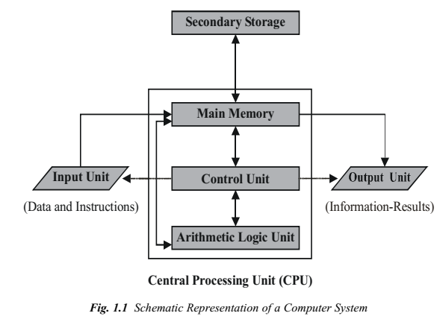
SYSTEM COMPONENTS

Slide 14


